Slide 1

State of
U.S. Labor Markets and Economy in 2026
Where are we right now and where are we headed?
Presenter: Seth D. Harris, Senior Fellow and Distinguished Professor, Northeastern University and the Burnes Center for Social Change
Notes:
My name is Seth Harris.
I am a Senior Fellow at the Burnes Center for Social Change at Northeastern University and the project leader for this skills-based hiring pilot project in partnership with New Jersey’s Civil Service Commission.

Slide 2
Three Discussion Points
Point #1: Labor markets are slowing, but the economy is growing, although workers aren’t sharing in the proceeds fairly.
Point #2: Labor supply is shrinking.
Point #3: Artificial intelligence is going to have both short-term and long-term effects on the labor market.

Slide 3
Point #1 Headlines
Point #1: Labor markets are slowing, but the economy is growing, although workers aren’t sharing in the proceeds fairly.
The U.S. is experiencing healthy economic growth, although there are some caveats.
A large and rising share of the wealth being produced is going into the pockets of capital, not labor.
Employers are hugging their incumbent employees.
Employers have slowed their hiring.
Unemployment is up; fewer jobs are open.
Real wage growth has slowed because inflation remains above 2%

Slide 4
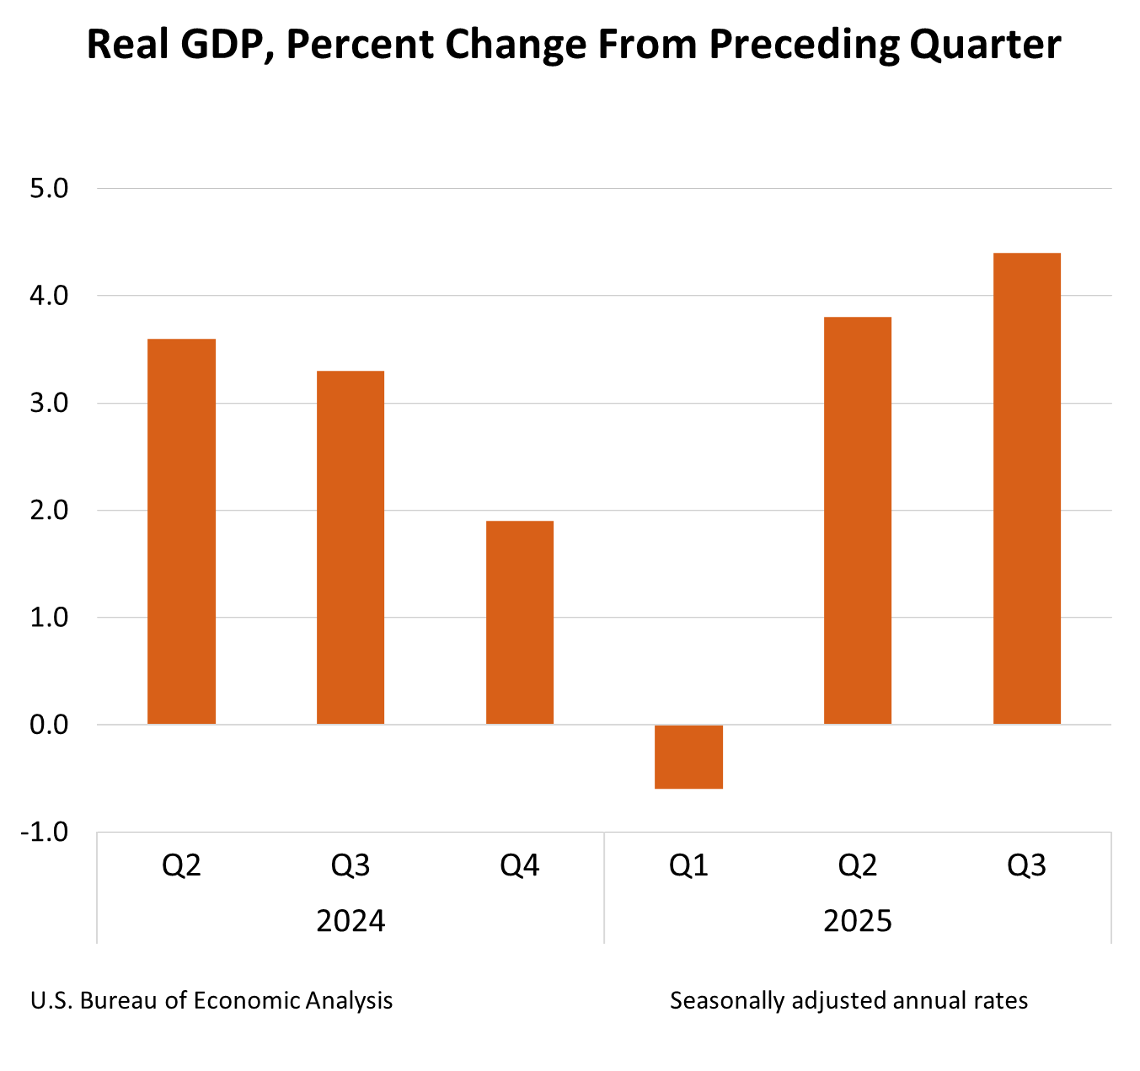
The economy is growing.

Slide 5
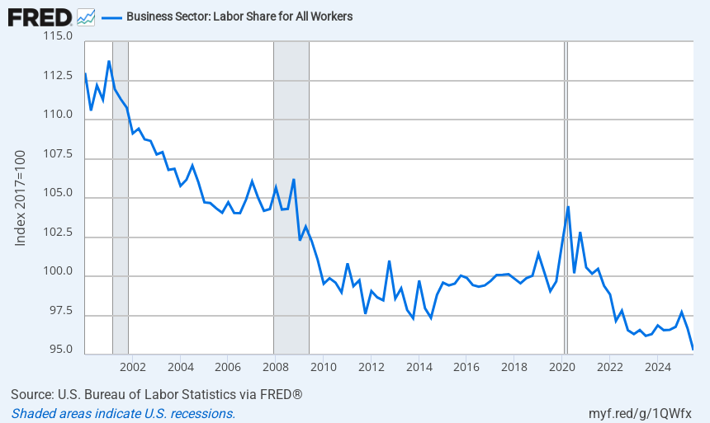
More wealth for capital, less for working people.
Notes:
Source:
U.S. Bureau of Labor Statistics
Release:
Productivity and Costs
Units:
Index 2017=100, Seasonally Adjusted
Frequency:
Quarterly
U.S. Bureau of Labor Statistics,
Business Sector: Labor Share for All Workers [PRS84006173],
retrieved from FRED,
Federal Reserve Bank of St. Louis;
https://fred.stlouisfed.org/series/PRS84006173,
January 27, 2026.

Slide 6
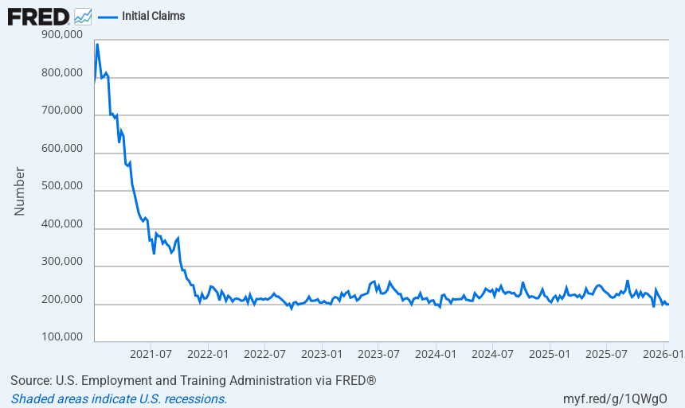
Employers are hugging their incumbent employees.
Notes:
Source:
U.S. Employment and Training Administration
Release:
Unemployment Insurance Weekly Claims Report
Units:
Number, Seasonally Adjusted
Frequency:
Weekly, Ending Saturday
An initial claim is a claim filed by an unemployed individual after a separation from an employer. The claim requests a determination of basic eligibility for the Unemployment Insurance program.
U.S. Employment and Training Administration,
Initial Claims [ICSA],
retrieved from FRED,
Federal Reserve Bank of St. Louis;
https://fred.stlouisfed.org/series/ICSA,
January 27, 2026.

Slide 7
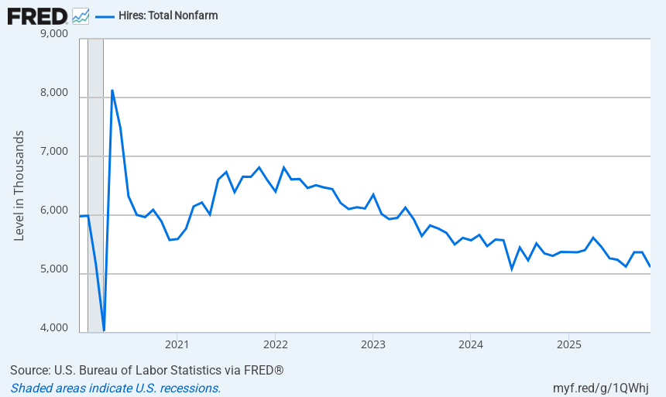
Hiring has slowed.
Notes:
Source:
U.S. Bureau of Labor Statistics
Release:
Job Openings and Labor Turnover Survey
Units:
Level in Thousands, Seasonally Adjusted
Frequency:
Monthly
U.S. Bureau of Labor Statistics,
Hires: Total Nonfarm [JTSHIL],
retrieved from FRED,
Federal Reserve Bank of St. Louis;
https://fred.stlouisfed.org/series/JTSHIL,
January 27, 2026.

Slide 8
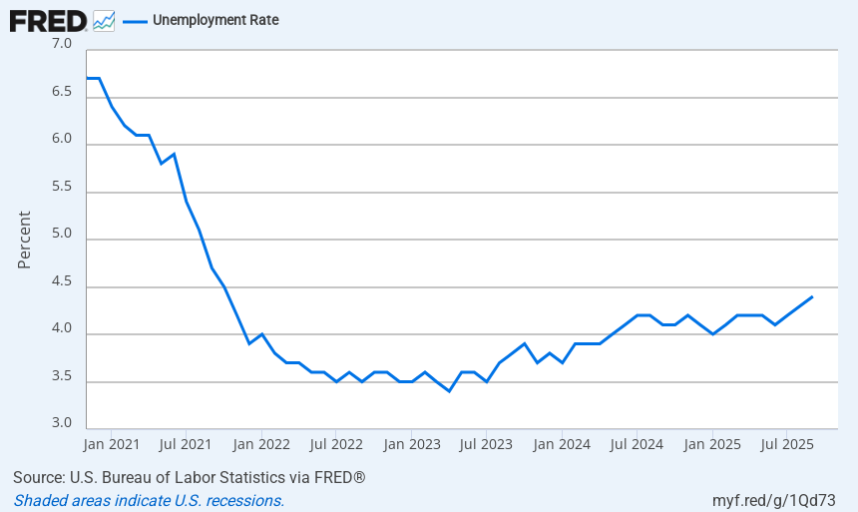
Unemployment rate is up.

Slide 9
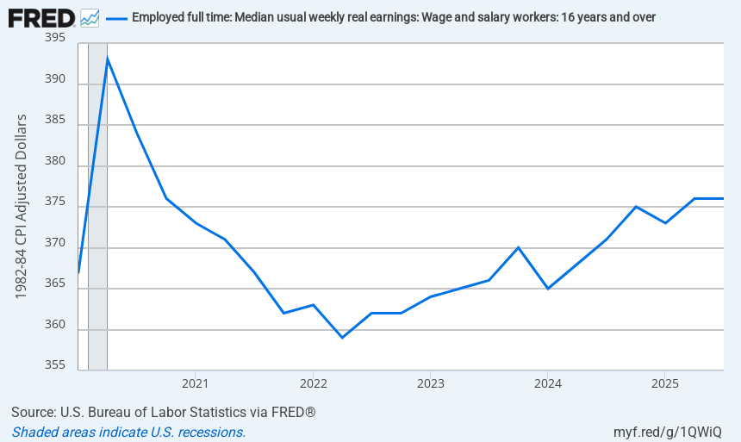
Real earnings have been flat for three quarters after rising.
Notes:
Source:
U.S. Bureau of Labor Statistics
Release:
Weekly and Hourly Earnings from the Current Population Survey
Units:
1982-84 CPI Adjusted Dollars, Seasonally Adjusted
Frequency:
Quarterly
Data measure usual weekly earnings of wage and salary workers. Wage and salary workers are workers who receive wages, salaries, commissions, tips, payment in kind, or piece rates. The group includes employees in both the private and public sectors but, for the purposes of the earnings series, it excludes all self-employed persons, both those with incorporated businesses and those with unincorporated businesses.Usual weekly earnings represent earnings before taxes and other deductions and include any overtime pay, commissions, or tips usually received (at the main job in the case of multiple jobholders). Prior to 1994, respondents were asked how much they usually earned per week. Since January 1994, respondents have been asked to identify the easiest way for them to report earnings (hourly, weekly, biweekly, twice monthly, monthly, annually, or other) and how much they usually earn in the reported time period. Earnings reported on a basis other than weekly are converted to a weekly equivalent. The term "usual" is determined by each respondent's own understanding of the term. If the respondent asks for a definition of "usual," interviewers are instructed to define the term as more than half the weeks worked during the past 4 or 5 months. Visit the BLS for more information.The series comes from the 'Current Population Survey (Household Survey)'The source code is: LES1252881600
U.S. Bureau of Labor Statistics,
Employed full time: Median usual weekly real earnings: Wage and salary workers: 16 years and over [LES1252881600Q],
retrieved from FRED,
Federal Reserve Bank of St. Louis;
https://fred.stlouisfed.org/series/LES1252881600Q,
January 27, 2026.

Slide 10
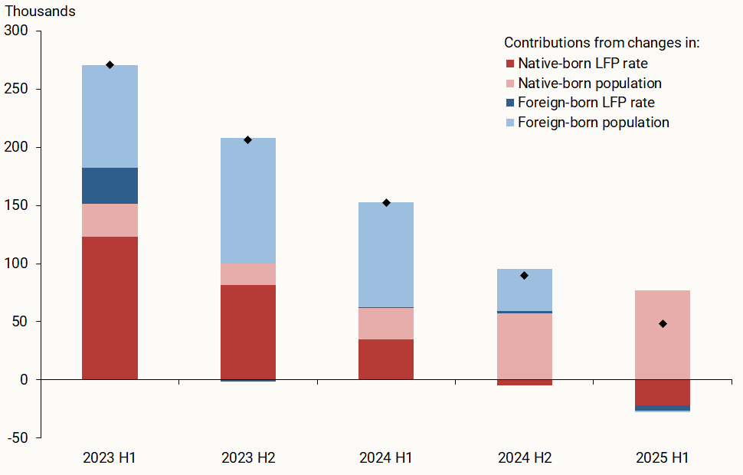
Point #2: Fewer foreign workers are working less.
Notes:
Source:
U.S. Bureau of Labor Statistics
Release:
Weekly and Hourly Earnings from the Current Population Survey
Units:
1982-84 CPI Adjusted Dollars, Seasonally Adjusted
Frequency:
Quarterly
Data measure usual weekly earnings of wage and salary workers. Wage and salary workers are workers who receive wages, salaries, commissions, tips, payment in kind, or piece rates. The group includes employees in both the private and public sectors but, for the purposes of the earnings series, it excludes all self-employed persons, both those with incorporated businesses and those with unincorporated businesses.Usual weekly earnings represent earnings before taxes and other deductions and include any overtime pay, commissions, or tips usually received (at the main job in the case of multiple jobholders). Prior to 1994, respondents were asked how much they usually earned per week. Since January 1994, respondents have been asked to identify the easiest way for them to report earnings (hourly, weekly, biweekly, twice monthly, monthly, annually, or other) and how much they usually earn in the reported time period. Earnings reported on a basis other than weekly are converted to a weekly equivalent. The term "usual" is determined by each respondent's own understanding of the term. If the respondent asks for a definition of "usual," interviewers are instructed to define the term as more than half the weeks worked during the past 4 or 5 months. Visit the BLS for more information.The series comes from the 'Current Population Survey (Household Survey)'The source code is: LES1252881600
U.S. Bureau of Labor Statistics,
Employed full time: Median usual weekly real earnings: Wage and salary workers: 16 years and over [LES1252881600Q],
retrieved from FRED,
Federal Reserve Bank of St. Louis;
https://fred.stlouisfed.org/series/LES1252881600Q,
January 27, 2026.

Slide 11

Point #3: Will artificial intelligence kill all our jobs?
Three Scenarios:
AI is Highly Disruptive and Destructive: Mass Displacement, Structural Unemployment, and Labor Market Fragmentation
Moderately Disruptive: Job Reconfiguration and Mixed Outcomes
Mildly Disruptive and Productive: Human-Centric AI Deployment and Widespread Augmentation

Slide 12
Selected Inventions with Expected Employment Effects Since WW II
Nuclear Power (1942–1945)
Credit Cards & Digital Payments (1950s–present
Shipping Container (1956)
Integrated Circuit (1958–1960s)
Microprocessor (1971)
Personal Computers (1975–1977)
Cellular Phones and, later, Smart Phones (Commercial service launched in 1983
World Wide Web (Popularized mid-1990s in U.S.)
GPS (Fully operational by 1995)
CRISPR Gene Editing (2012)
3D Printing (2010s and developing)

